Slide 1
Low-Cost Environmental Adjustments for Community Members Who Are Hard of Hearing
Colette Reasonover, M.A., M.S.W.
NJAAW - Making Your Senior Center - and Community Spaces - Hearing Friendly
08/18/2026

Slide 2

Overview
Utilize Surfaces
Mixing hard and soft surfaces to balance noise
Dampen Noise
Strategically use fabric/foam to absorb noise
Isolate the Space
Seal windows and doors to limit noise from the outside
Shape the Room
Orient the space to improve communication

Slide 3
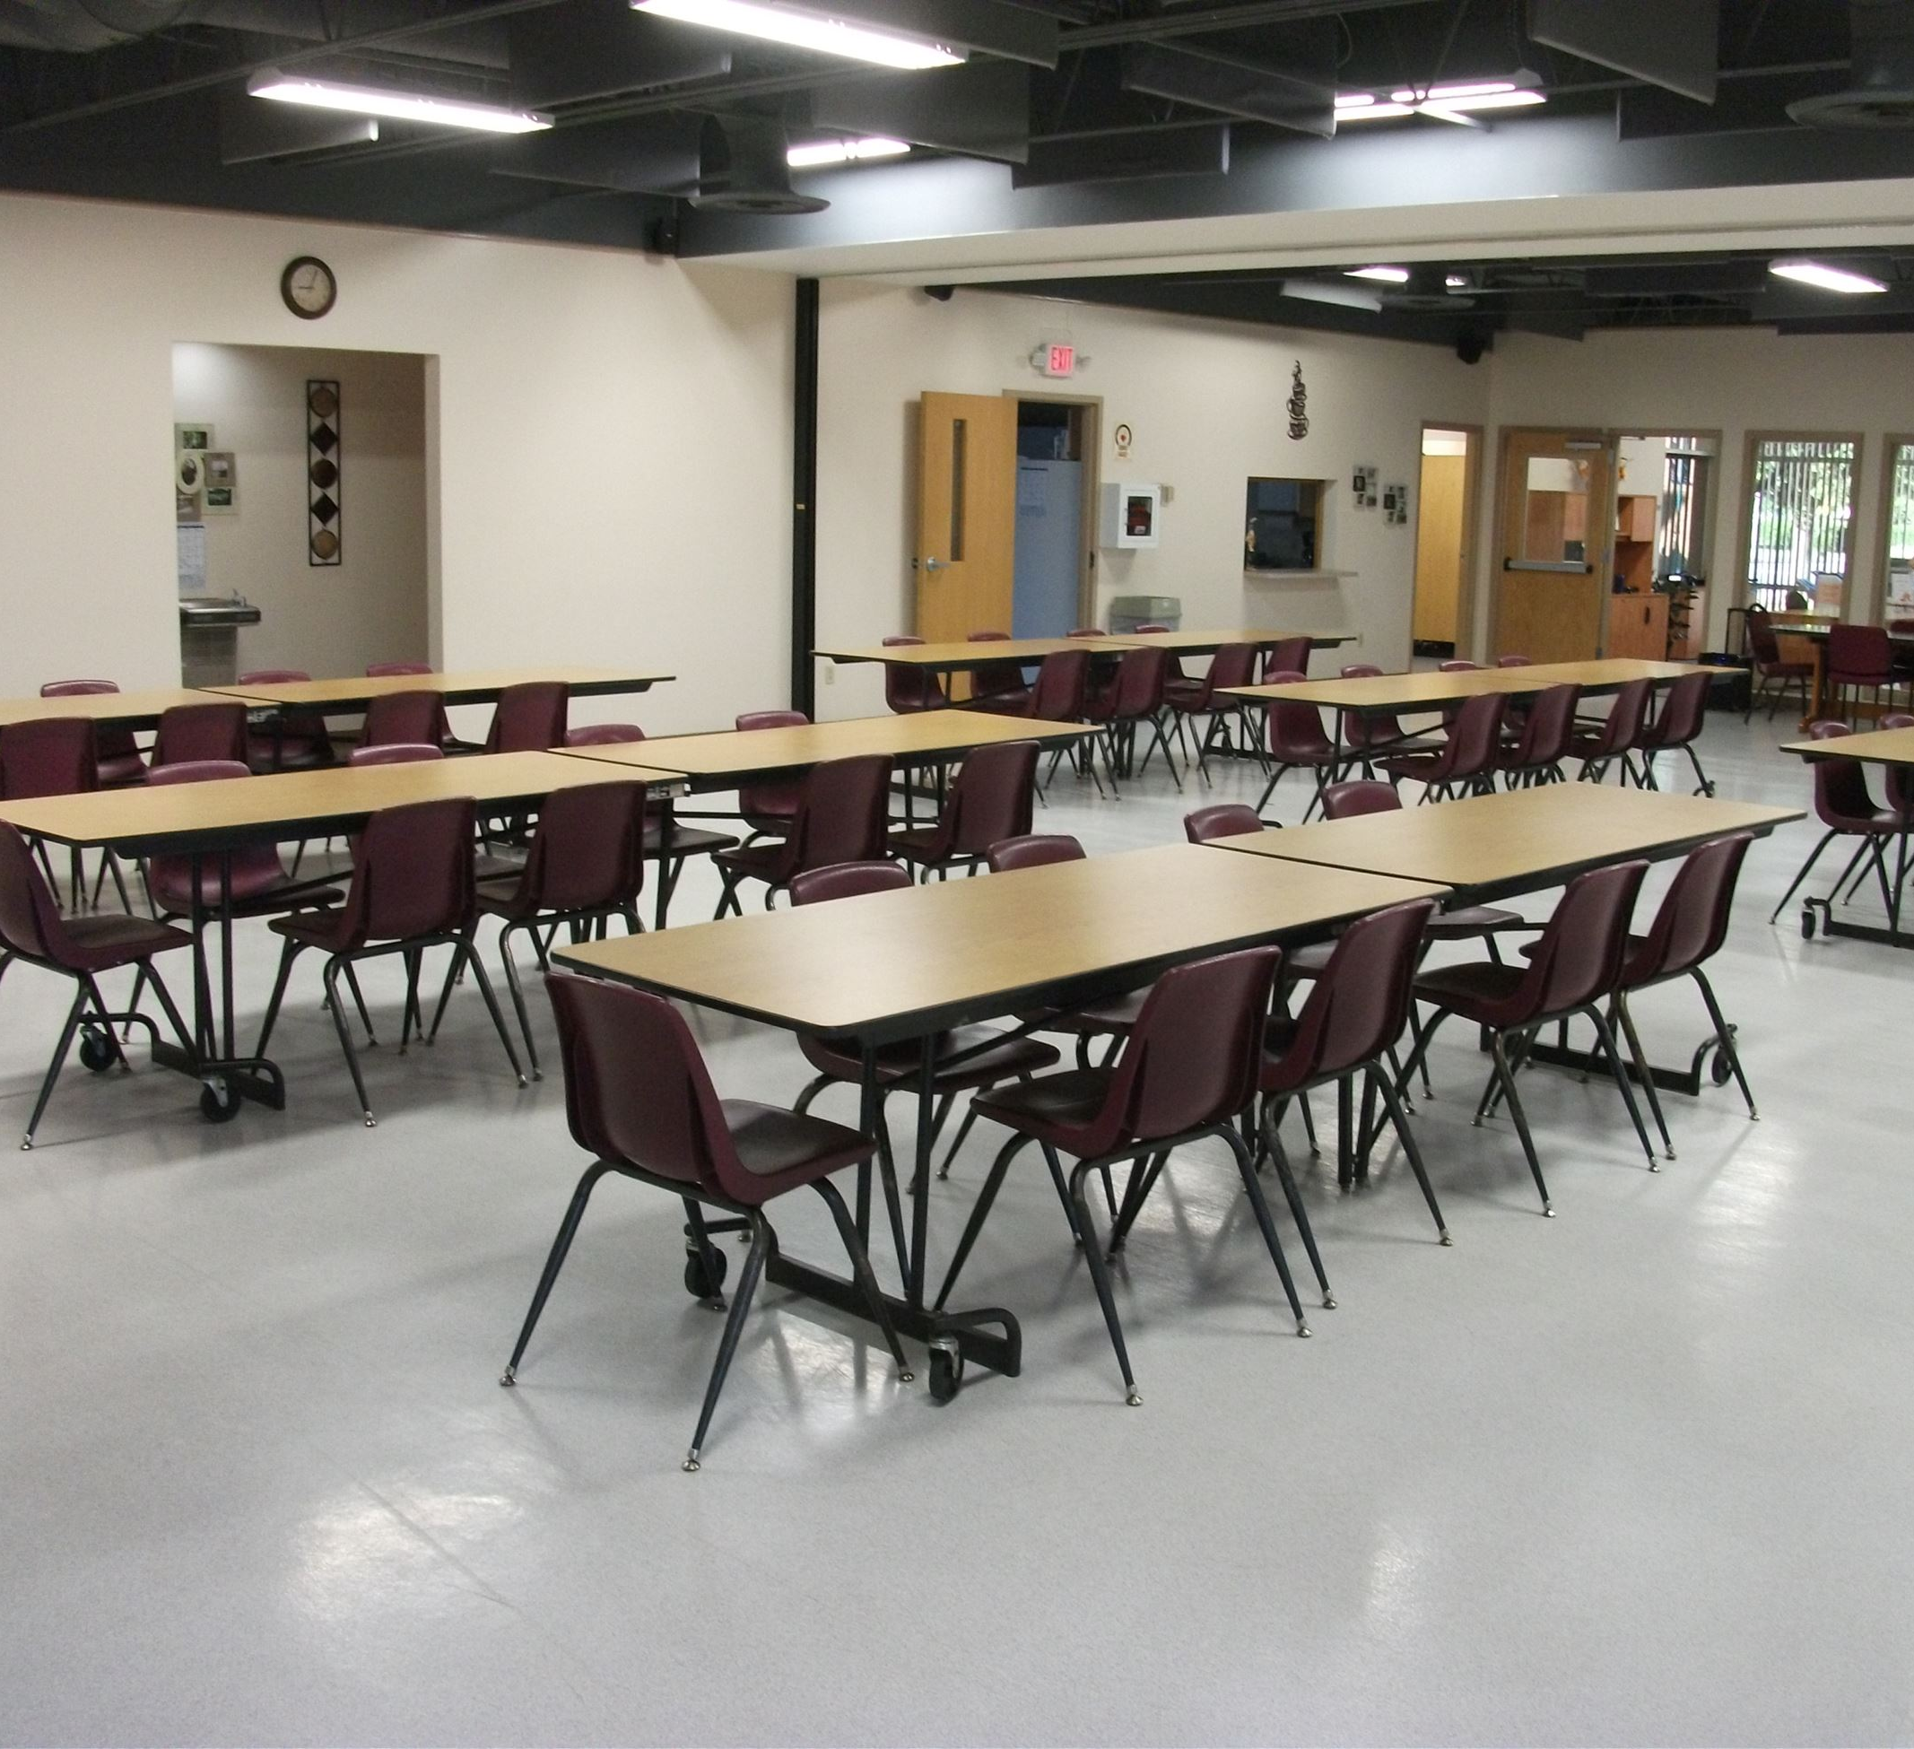
Hard Surfaces: Pros and Cons
Pros:
  Easy to clean
  Limits tripping hazards
  Easy for wheelchair and walker users
  Probably what you already are working with
Cons:
  Reflects noise
  Contributes to visual glare
    If the hard surfaces are not fully matte
  Can be less visually appealing
    Tends to look more corporate/hospital like

Slide 4
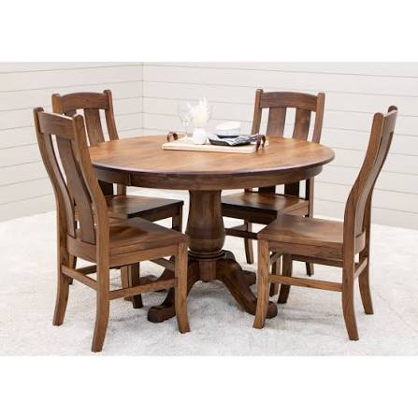
Surfaces: Working with What You’ve Already Got
Cluster seating
  Putting chairs in circular formations with a maximum diameter of 4 ft is recommended
Move seating areas away from constant internal or external sources of noise
  For example, air conditioners, windows facing the street, next to a hallway, etc.
Keep anything on table below eye level
  For example, use a small votive for flowers rather than a tall vase
Optimize lighting for visual cues
Cost: $0

Slide 5
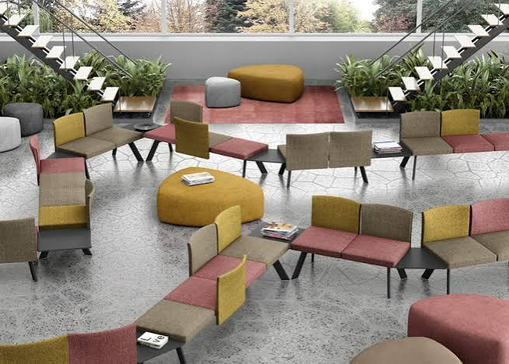
Shape of the Room
Parallel Walls
  Arrange furniture to break up the parallel elements
    E.g. bookcases against the wall, standing partitions, etc.
Corners
  Concentrate absorptive materials in corners
    For example, a chair with pillows in the corner
  Avoid placing tables in/near corners
Dispersion
  Avoid regular arrangement of furniture when possible
    For example, rows of tables & chairs
Cost: $0
Notes:
Parallel walls cause noise to ping-pong back and forth across the space
Corners often trap noise, especially low frequency noise
Creating irregular furniture arrangements helps avoid the creation of sound corridors and disperses sound across the room

Slide 6
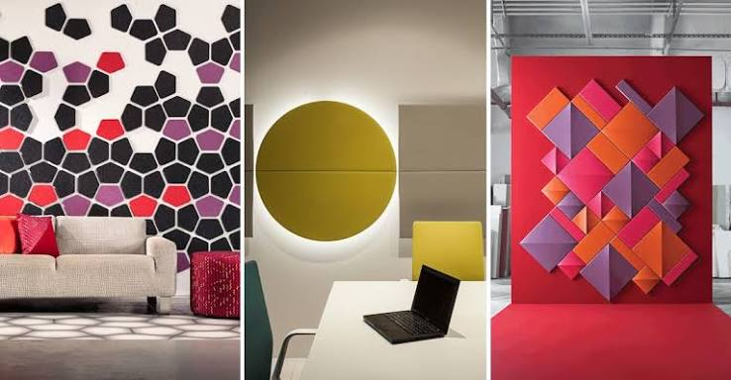
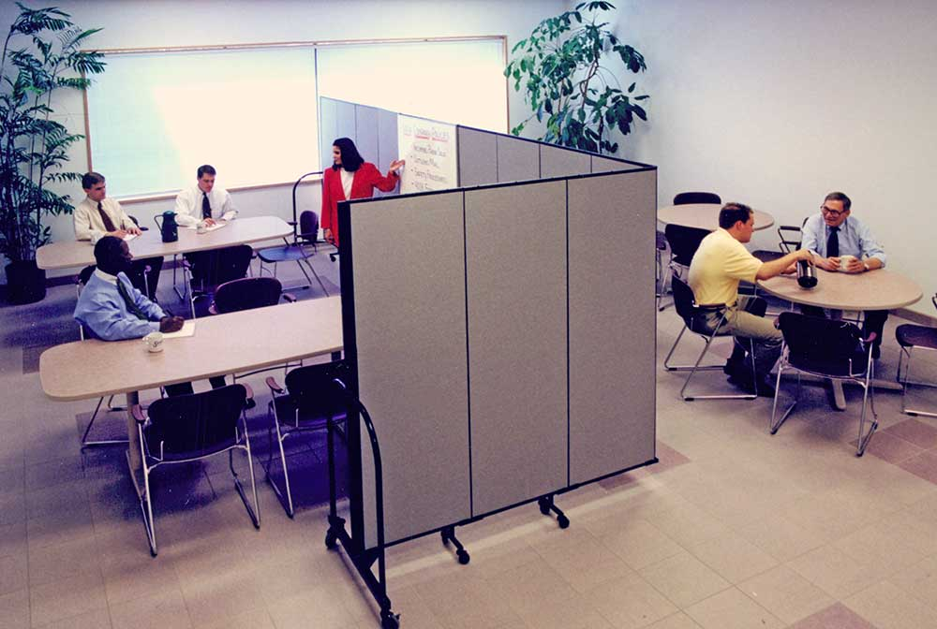
Sound Absorption: Adding to Your Space
Heavy Curtains
Throw pillows
Pads on the bottom of chairs and table legs
  Limits noise from furniture being moved
Strategic placement of acoustic foam
  Underside of chairs and tables, and on walls
Partitions to disperse noise
Cost: ~$109
Notes:
Rugs can also be used but are left out due to the tripping risk.

Slide 7
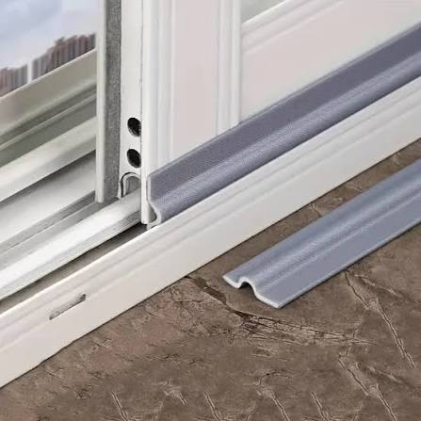
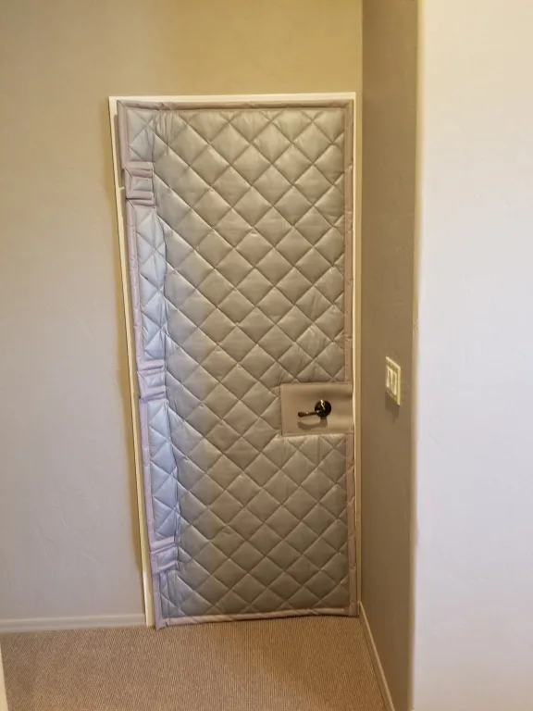
Isolating the Space
Outside or background noise can significantly impact hearing
  Especially true for people using devices to assist with hearing
Consider what is going on outside of the windows
  If one side is facing a street, and the other is facing a yard, focus on the side facing the street
Foot traffic from hallways is impactful
  Wear comfy shoes, hard soles can reverberate
  Close the door when possible
Replace/improve gaskets along doorways & windows
Use acoustic blankets on back of utility and closet doors
Cost: $55

Slide 8
Items for Purchase
Dampen Noise
Curtains - $10
Foam - $14
Pillows - $10
Pads - $10
Acoustic Panels - $30
Room Divider - $35
Isolating the Space
Door/Window Seal - $14
Weather Stripping - $8
Acoustic Blanket - $33
Total Cost: $164

Slide 9
Resources
DeafSpace Design Guidelines
Architecture for People with Hearing Loss: 6 Design Tips
How Architects Shape Social Wellbeing Through Acoustics
Acoustics 101 for Architects

Slide 10



Thank you!
Website:
http://socialwork.rutgers.edu/aging
agingcollab@ssw.rutgers.edu
For more information, visit http://socialwork.rutgers.edu/aging
Colette Reasonover
cmr456@scarletmail.rutgers.edu
LinkedIn:
https://go.rutgers.edu/HubLinkedIn
Join Email List:
https://go.rutgers.edu/JoinHubEmail
Hub for Aging Collaboration, Rutgers School of Social Work
Notes:
Thank you for your time and attention. We look forward to the rest of the presentations in today's session and to our conversation together. Thank you.

